Slide 1
Project Title: Predicting students engagement using machine learning techniques
Instructor: Prof. Mari Ostendorf
Student: Neha Kardam
EE511: Introduction to Statistical Learning
Winter 2021

Slide 2
TASK DESCRIPTION
Problem: Regression
Input (X) : Student Information
Numeric variable (ex. Age, GPA)
Discrete variables (ex. Class, Gender, Race)
Output (Y) : Students Engagement Scale
Effort Scale
Belonging Scale
Peer Support Scale
Faculty Support Scale
Positive Emotional Engagement scale
Evaluation: Mean Square Error
134 FEATURES
1053 SAMPLES
Notes:
The goal of this project is to understand what factors are good predictors of the course-level engagement.
There are total 138 features I have considered in this project.
These forms of engagement scales are created based on survey responses received by the students during remote learning and traditional learning environment.

Slide 3
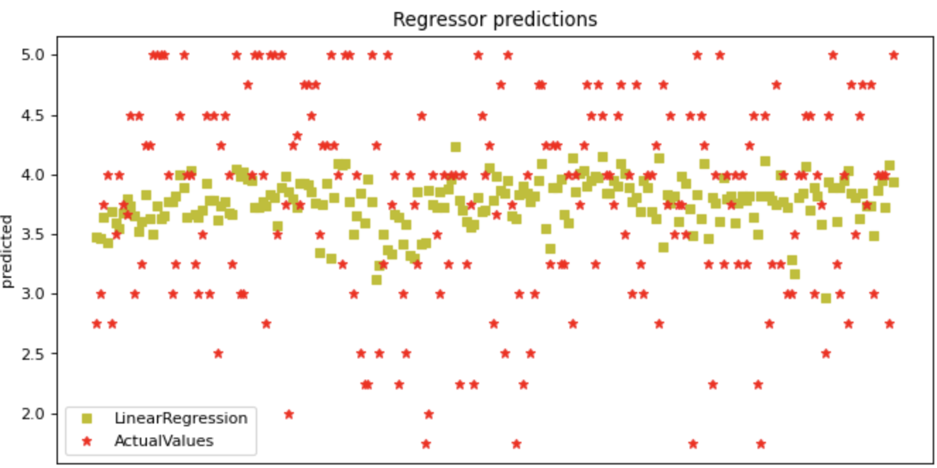
APPROACH & BASELINE
Approach:
Pre-Processing
Data Split (80% Train vs 20% Test)
One Hot Encoding
Standard Scaling
Model Selection
Hyperparameter Tuning using Cross Validation
Baseline: Ordinary Least Squares (OLS)
Notes:
Loading the data and defining numerical and discrete variables and then handling any missing values, so, missing discrete value assigned as nan (special string) and missing numerical value as 0.
Splitting the data into train and test
One hot encoding was used for transforming discrete features into binary features,
Standard scaling: It is used to normalized the features by subtracting the mean and dividing by standard deviation (Centering and scaling happen independently on each feature)
Model Selection : I used multiple models in this projects which you will see in the next slide
Hyper parameter tuning I used Gridsearch CV , it implements fit and score methods (Gridsearch do an exhaustive search over specified parameter values for an estimator).
OLS: Ordinary Least Squares or OLS is one of the simplest methods of linear regression. OLS minimize the sum of the squared errors (a difference between observed values and predicted values). The goal of OLS is to closely "fit" a function with the data. It does so by minimizing the sum of squared errors from the data.
OneHotEncoder transforms each categorical feature with n_categories possible values into n_categories binary features, with one of them 1, and all others 0.
Ordinary Least Squares (OLS) method is widely used to estimate the parameter of a linear regression model. OLS estimators minimize the sum of the squared errors (a difference between observed values and predicted values)

Slide 4
EXPERIMENTS
 | OLS | Ridge | Lasso | Elastic | GLR- Poisson | GLR-Gamma | Elipson SVM | NU SVM | Stochastic Gradient descent
Effort | 0.7639 | 0.7125 | 0.7598 | 0.7254 | 0.7183 | 0.7229 | 0.7601 | 0.7598 | 0.7539
Belonging | 0.6079 | 0.5857 | 0.5941 | 0.6015 | 0.5830 | 0.6216 | 0.5942 | 0.5942 | 0.6120
Faculty Support | 0.5553 | 0.5328 | 0.5432 | 0.5432 | 0.5425 | 0.5430 | 0.5454 | 0.5455 | 0.5437
Peer Support | 0.6740 | 0.6767 | 0.6851 | 0.6851 | 0.6803 | 0.6768 | 0.6851 | 0.6850 | 0.6750
Positive Emotional Engagement | 0.6384 | 0.6314 | 0.7339 | 0.7339 | 0.6303 | 0.6402 | 0.7427 | 0.7380 | 0.6911
Models
Scales
Notes:
Model Selection : I used multiple models in this projects for example ,
OLS: IT estimates unknown parameter in a linear regression model.
Ridge regression : addresses some of the problems of OLS by imposing a penalty on the size of the coefficient
Lasso regression : estimates sparse coefficients, L2 panelty
Elastic regression : It is a linear regression model trained with both ℓ1 and ℓ2-norm regularization of the coefficients. This combination allows for learning a sparse model where few of the weights.
Generalized Linear Regression (Poisson) : It used L2 regularization penalty. If the target values y are counts (non-negative integer valued) or relative frequencies (non-negative), you might use a Poisson deviance with log-link.
Generalized Linear Regression (Gamma) :If the target values are positive valued and skewed, you might try a Gamma deviance with log-link.
Elipson Support vector Machine : The implementation is based on libsvm. The free parameters in the model are C and epsilon
Nu SVM: Similar to SVC but uses a parameter to control the number of support vectors.
Stochastic Gradient Descent: it is particularly useful when the number of samples (and the number of features) is very large

Slide 5
THANK YOU!

